Slide 1
Under Armour: YouTube Data Aggregation and retrieval
Ian Robertson

Slide 2
Project Highlights
Setup Server
Installed/upgraded software
Configured applications
Created Dashboards & Visualizations
Created Email and Dashboard Alerting
Developed and ran ingest pipeline
Built data storage, and retrieval process

Slide 3
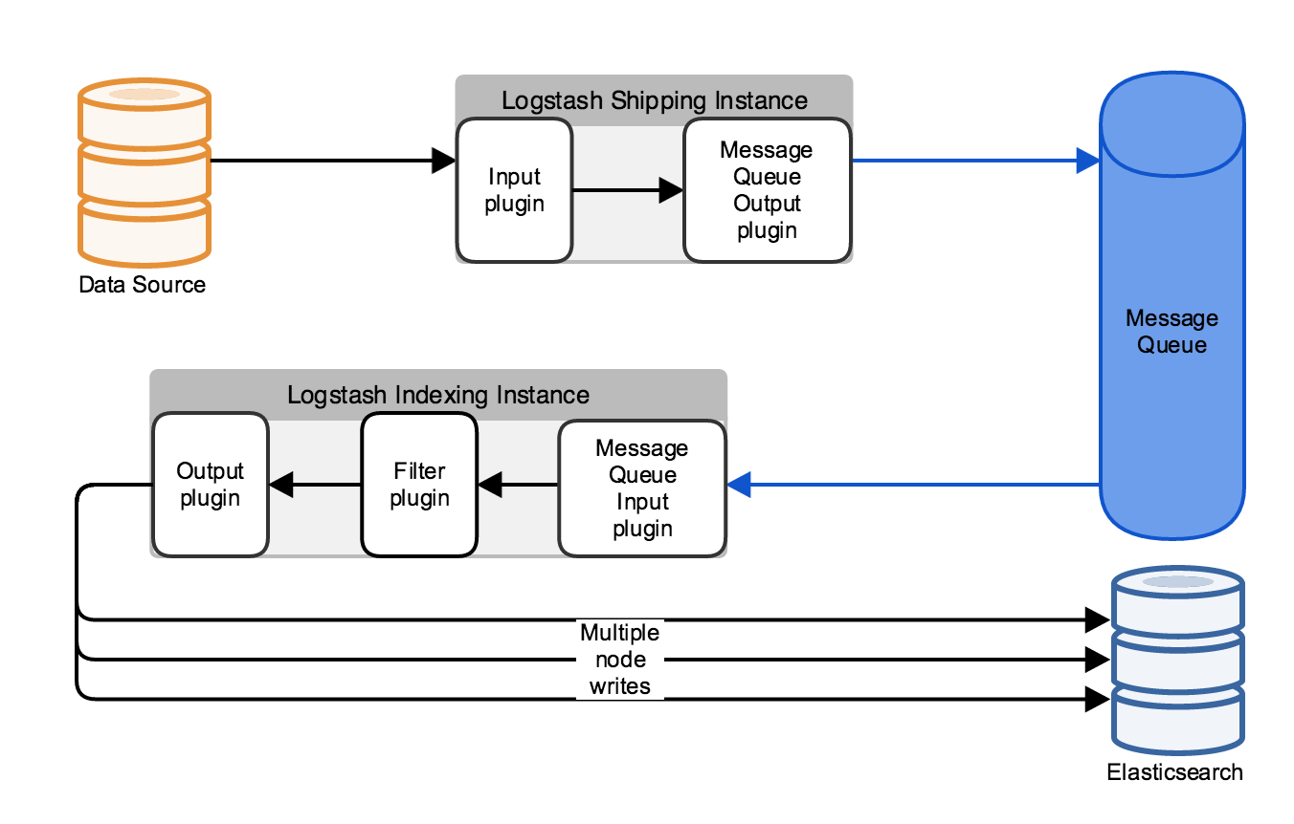
Ingest Pipeline

Slide 4
YouTube API
Allows you to gather videos as they are uploaded to YouTube or search existing content.
Filter criteria into topics, keyword, relevance, channels, or users

Slide 5
Ingest
General (All new)
Lifestyle
Fashion
Fitness
Technology
Under Armour Channel
Competition (Nike, Reebok, Adidas) Channels
**Topics (General Pipeline Parsing, TBD)

Slide 6
Dashboards and Widgets
Home dashboard
Alerting history
Visualizations
Competition
Innovation
Live Broadcast

Slide 7
Alerting
Frequency :
Uses: Occurrences of any given word
Example: 3 references to Under Armour in Title
New Term :
Uses: For finding new uses of specified value
Example: Finding New Channels in Fitness data
Spike:
Uses: Trending Events
Example: Increase in references to “shoe”

Slide 8
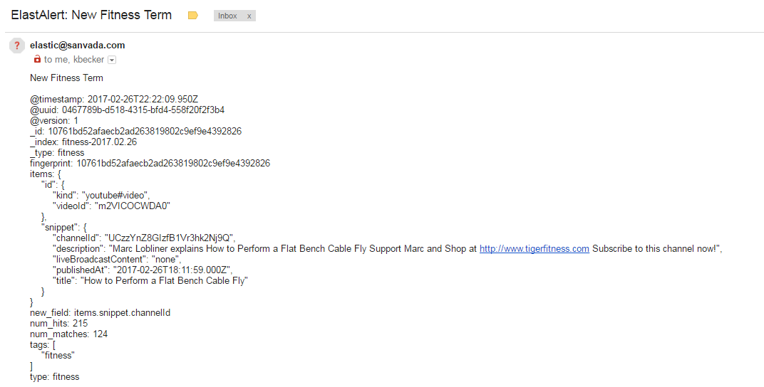
Email Alert

Slide 9
TODO:
Build out and format Alerting
Analytics
Scoring
Broaden:
View Count Metrics
Review Metrics
Languages
Search and process Channels and Rank by importance
Location?

Slide 10
Q&A

